Slide 1

Career Case Studies
“Together we support every child to achieve their full potential, instilling academic, social and independence skills, in order for them to flourish in the current and future world of work.”

Slide 2
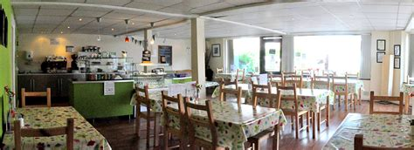
Case Study 1
Pupil 1 has Downs Syndrome and Learning Difficulties. Whilst at Bennerley Fields they accessed the careers and life skills programme. Life skills through Pathways to Adulthood included cooking and meal preparation; this, combined with learning to access work through the careers curriculum enabled them to have the skills to join the workplace. This pupil is employed at Rumbletums café near Nottingham which is a café who employ young adults with SEND in a variety of roles. Their role involves simple food preparation and taking orders to customers.

Slide 3
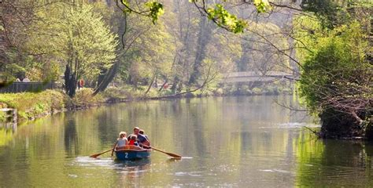
Case Study 2
Pupil 2 gained part time employment local to them in Matlock Bath. They are responsible for cleaning the rowing boats before being hired out to customers. They talk to members of the public and follow the cleaning routine specified by the company. They access the job independently. Preparation at Bennerley Fields included following routines, working independently and the development of key social skills. The careers curriculum has prepared them for access to the work environment and how to present in public.

Slide 4

Case Study 3
Pupil 3 has a job delivering garden furniture. This involves them working as part of team, listening to others and completing varied tasks following verbal instructions. Pupil 3 worked hard in school to use appropriate language and relating this to the workplace. They are now able to work independently and knows how to meet their own needs being out with a team in the van all day. They were given the opportunity at Bennerley Fields to reflect on building skills in the workplace so that they can update their skills profile on his CV to further their opportunities.

Slide 5

Case Study 4
Pupil 4 was supported in KS4 with alternative provision at Broomfield College to support their interest and talent in equestrian studies and riding. They accessed Level 2 in Horse Care which combined riding skills and stable management. Following their time at Bennerley Fields they progressed to Doncaster National Horse Racing College. They are accessing an apprenticeship course which includes Functional Skills English and Maths and Level 2 Equine Groom Apprenticeship incorporating stable management and riding. They have been fast tracked through the course due to is riding ability; supported with a mentor to look after their room and complete his laundry. They also have 1:1 tuition for their English and Maths and is accompanied by a therapy dog.

