Slide 1

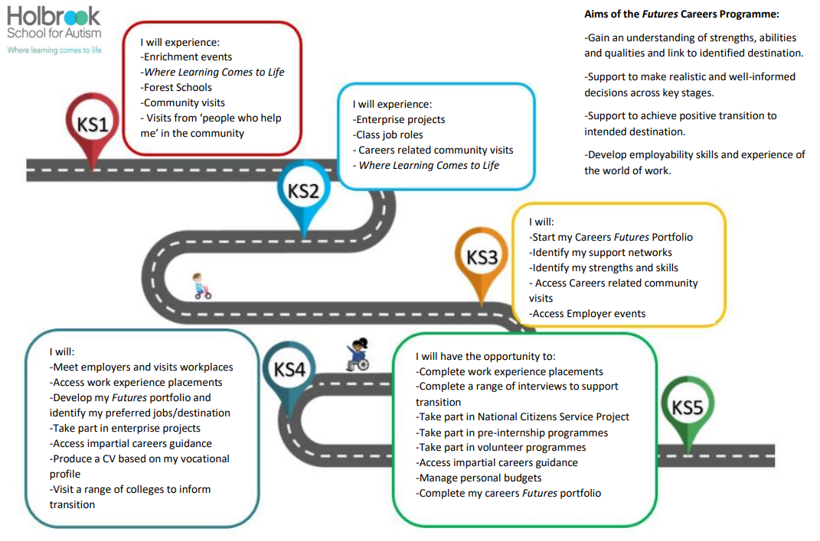
Aims of our Careers Curriculum:
•Prepare the pupils for transition and life ‘Beyond Bennerley’
•Support pupils to make informed decisions which are appropriate to them
•Provide opportunities for pupils to gain qualifications
•Provide employer encounter opportunities
•Develop personal characteristics such as social skills, communication, independence, increased self-esteem, confidence, resilience and ability to problem solve and apply functional skills
•Raise the aspirations of our pupils
During your child's journey at Bennerley Fields, you will be supported and involved along the way:
From Yr 7: Support skill development within the home via the Skills Builder HOMEZONE
Yr 8: Help connect with role models and attend careers / futures events.
Inspirational Role Model Video
You will be signposted to local futures events throughout the year.
Yr 7
Yr 8
Each year you are invited to:
Our Enterprise event
Access to speak to our Independent Careers Advisor
Parent and Carer meetings
Yr 9: Discuss post-16 options and information shared about local colleges and providers.
DCC – Local Offer
The most up to date information about local providers will be given to you to start making informed choices.
Yr 9
Yr 10: Access independent careers advice feedback and receive support and guidance with a specialist SEND advisor.
Ideas4Careers
Yr 11: Support with transition and next steps – via Family Support, SENCo, Careers Advisor, and Class Teams.
Health and social care for young people with SEND
Access to Work Scheme
We communicate our wide range of events, meetings and opportunities through a variety of channels including emails, social media and text messages.
Yr 10
Yr 11

